Slide 1
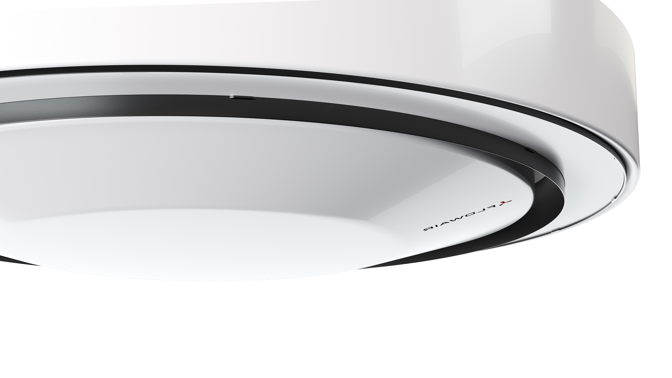

Luna
Heating and cooling

Slide 2
What is a Luna?
Luna is a ceiling-mounted device for heating and cooling rooms. Designed for use in facilities requiring increased aesthetic values.
Luna units are characterized by a long range and high power, which, combined with advanced automation, guarantees quick achievement of the set temperature even in the case of high rooms.
Intelligent temperature management algorithms combined with a fluent adjustable EC fan guarantee minimal energy consumption.
The innovative, automatically adjustable 360° air supply nozzle guarantees even air distribution, regardless of the operating mode of the device or the height of the room.

Slide 3
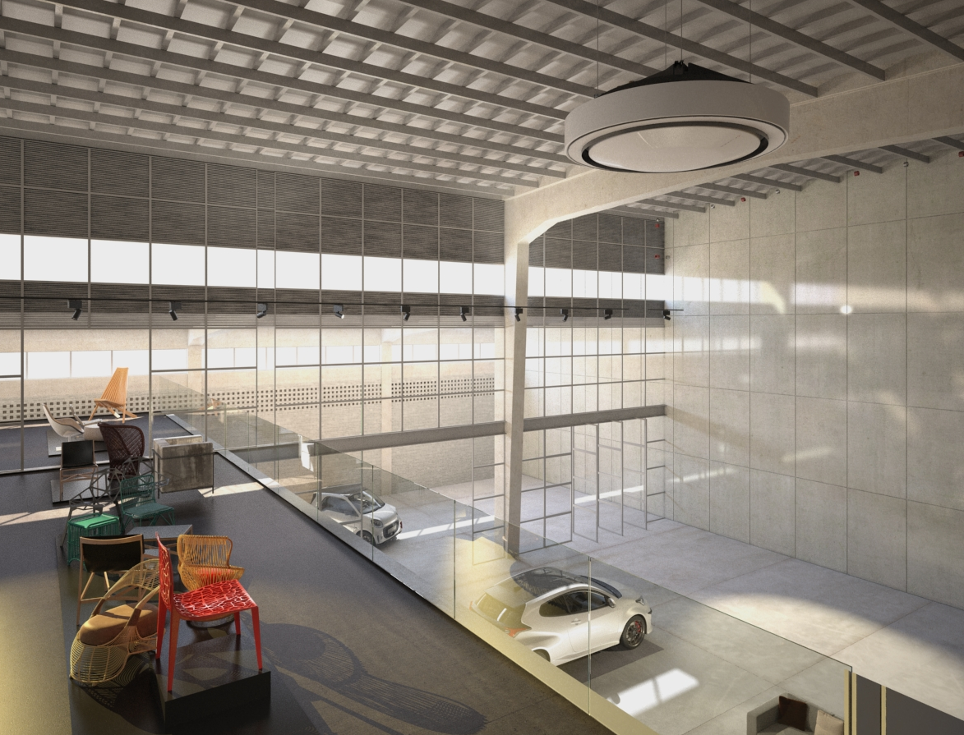
Luna
application
Commercial facilities:
car showrooms, restaurants, gyms, exhibition halls;
Retail industry:
supermarkets;
logistics facilities: distribution centers, warehouses;
medium-sized industrial building

Slide 4
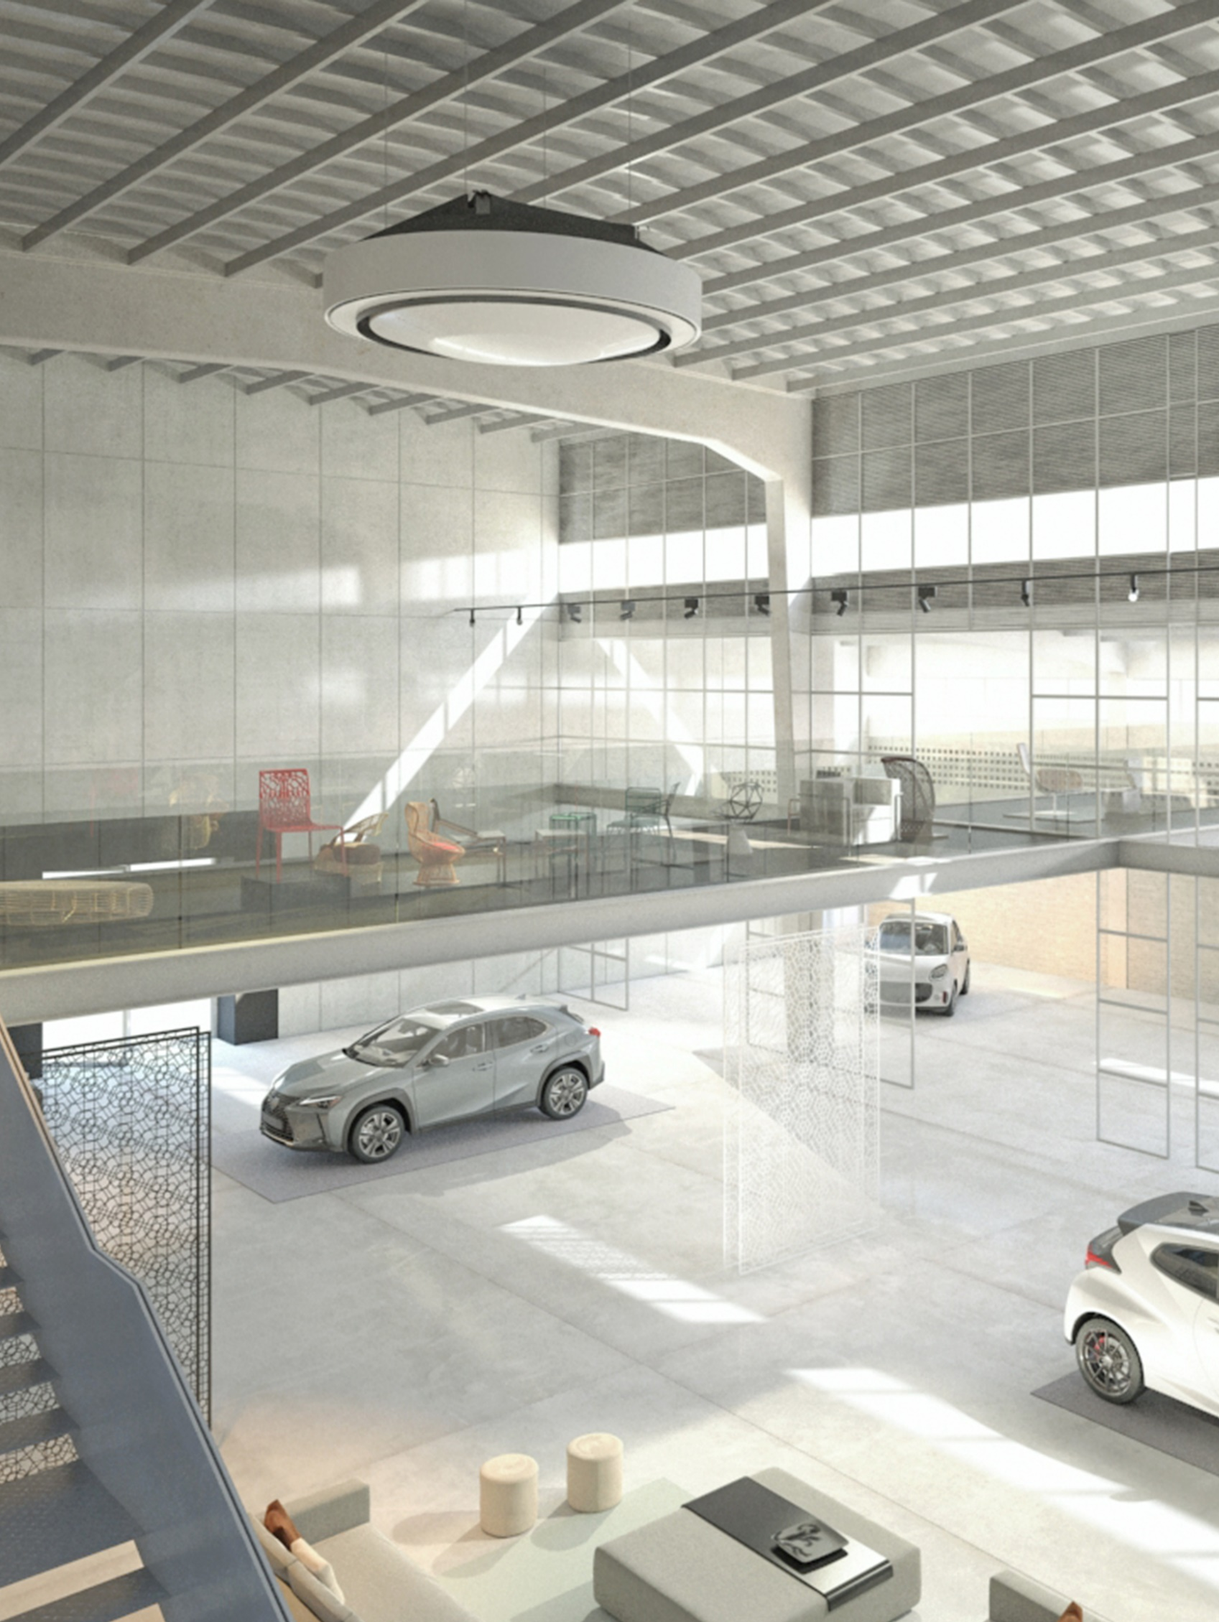

Device
functions
Heating
Cooling
Recirculation
Destratification
Air filtration (G4 standard filter)
Collaboration with heat sources (e.g. heat pumps)

Slide 5
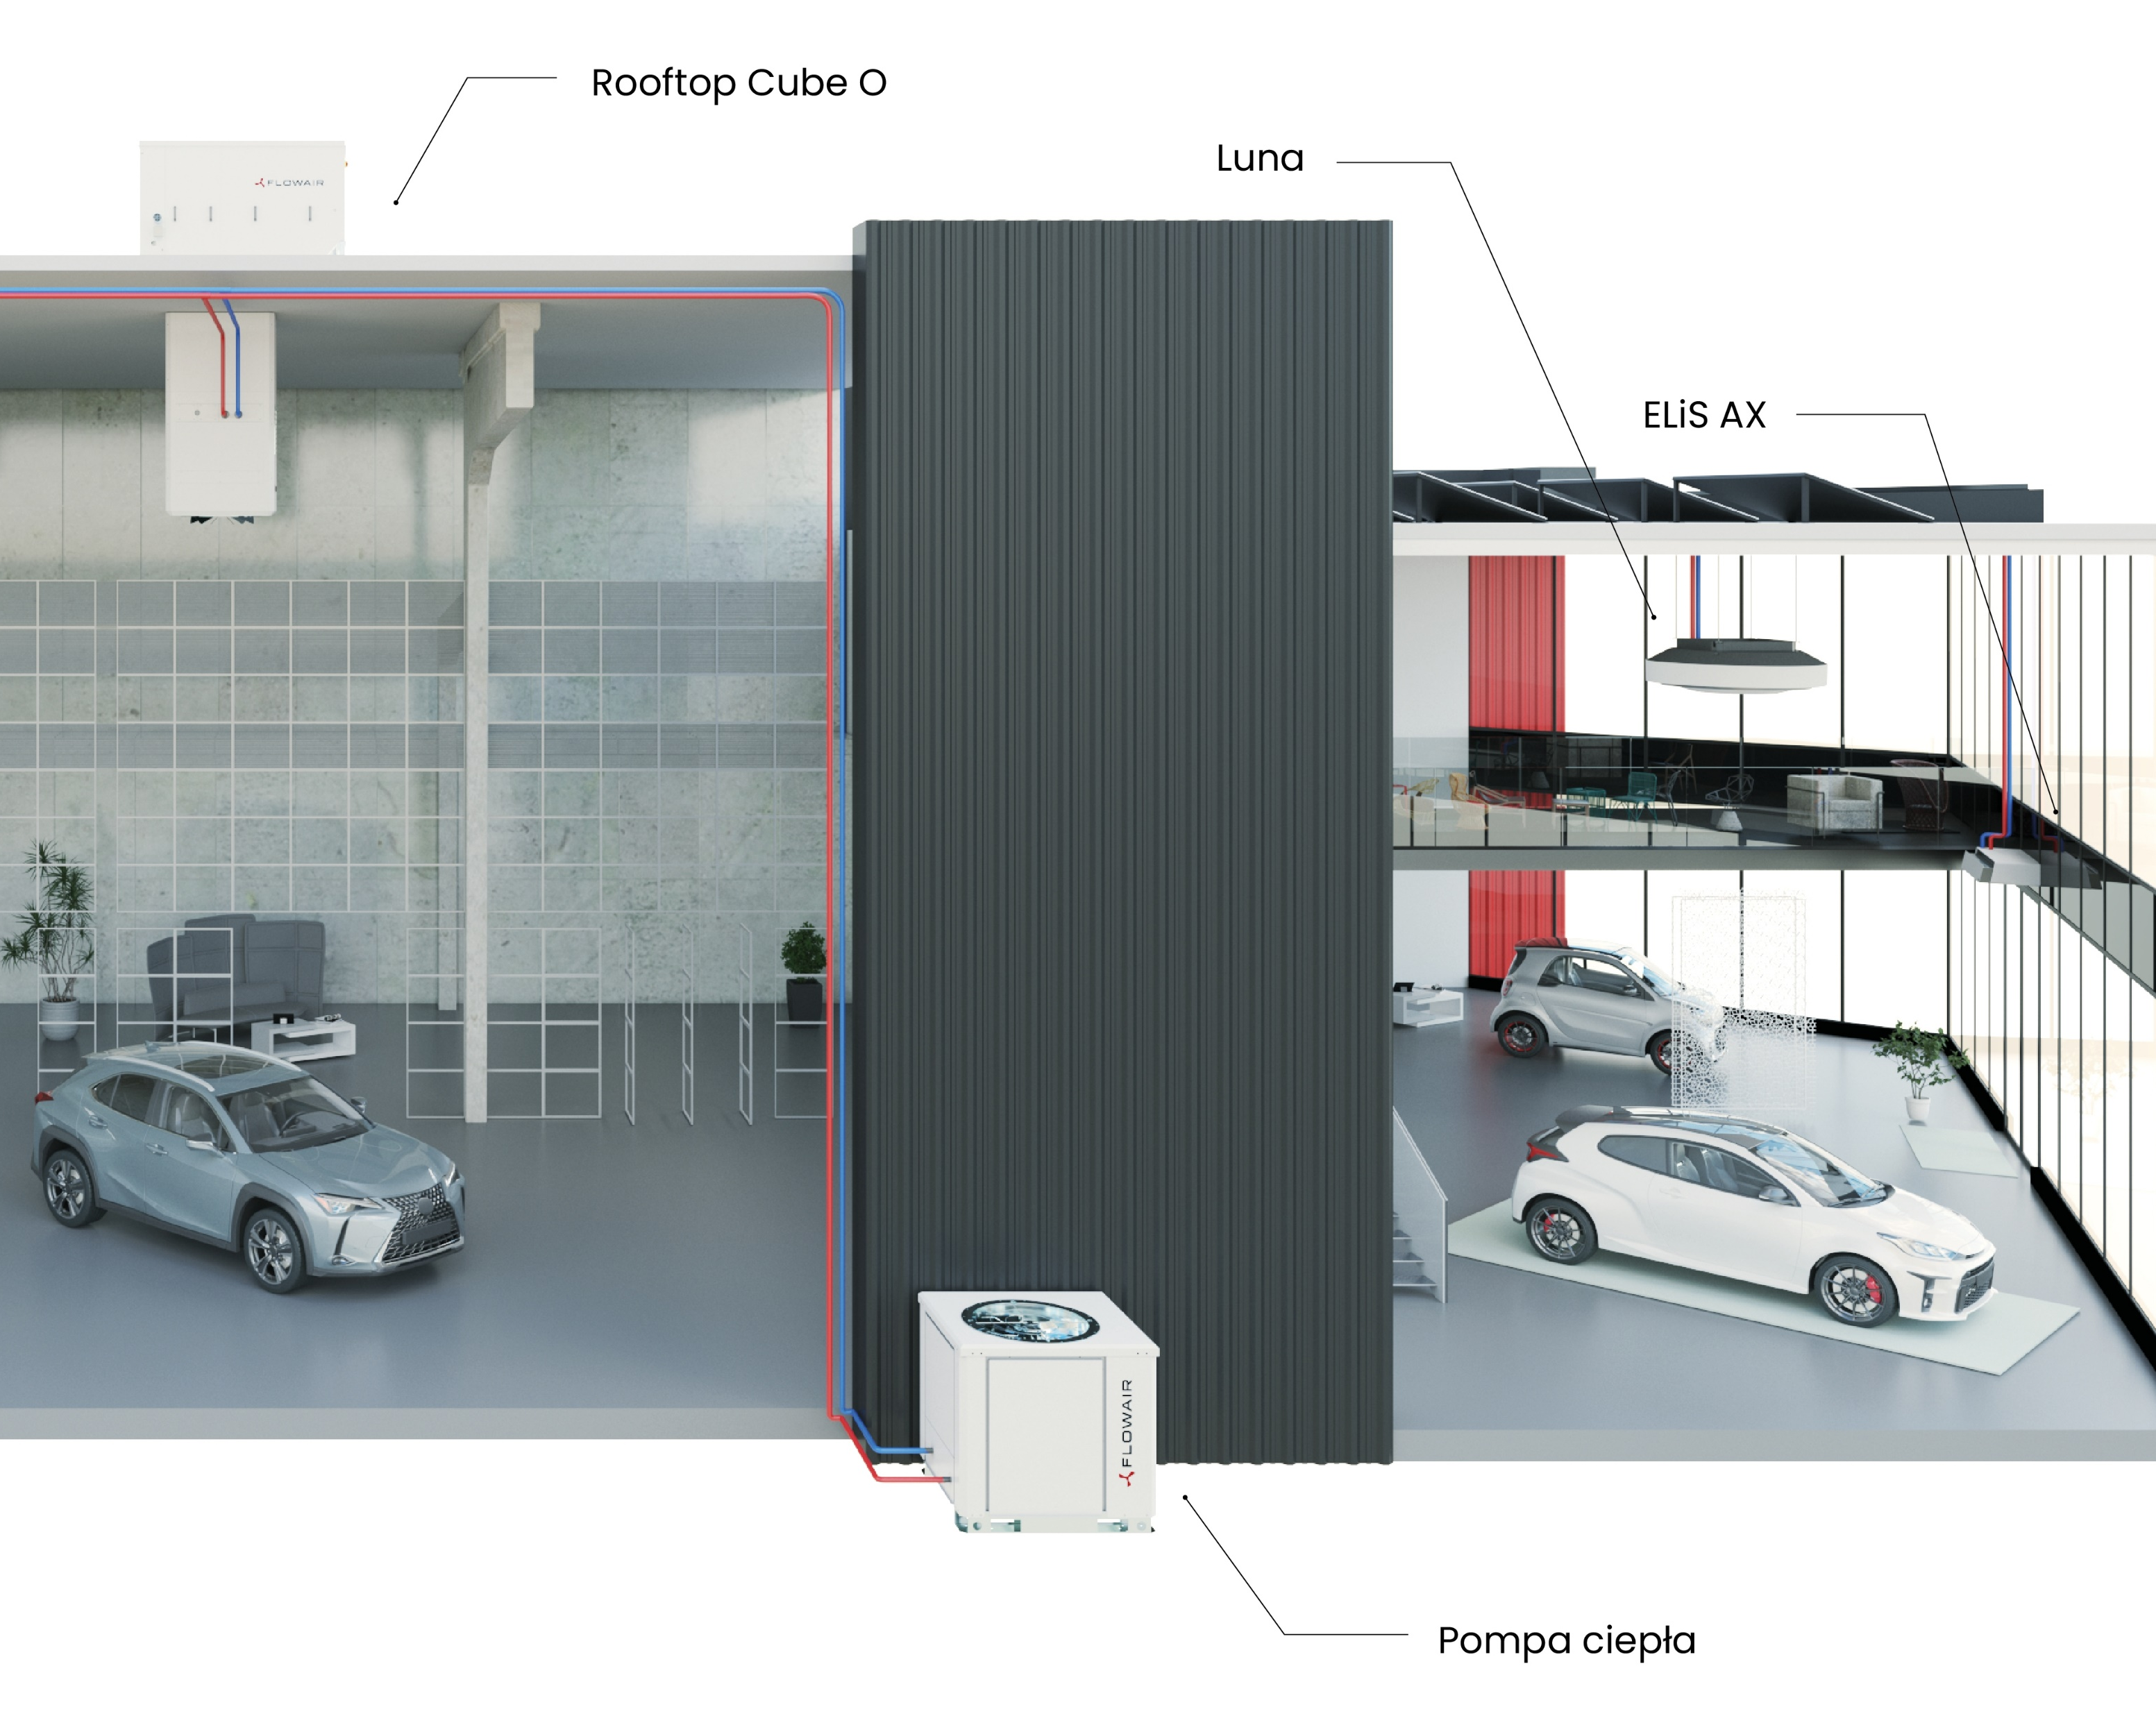
Collaboration
with heat pomps
Luna units are designed to collaborate with external heat/cool sources, such as heat pumps.

Slide 6
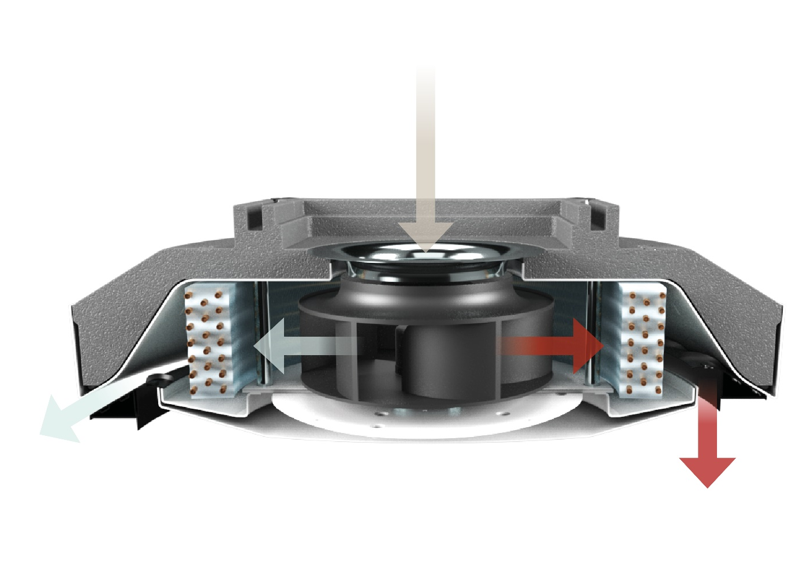
Principle of
operation
The air is drawn from above the device by a radial fan. It is then directed to the water heat exchanger and blown into the room through a movable 360° nozzle, at an appropriate angle depending on the device's operating mode.
Luna is designed to operate with recirculated air. However, by providing ventilation channels above the device, it can also work with ventilated or mixed air, enabling collaboration with Cube devices.

Slide 7
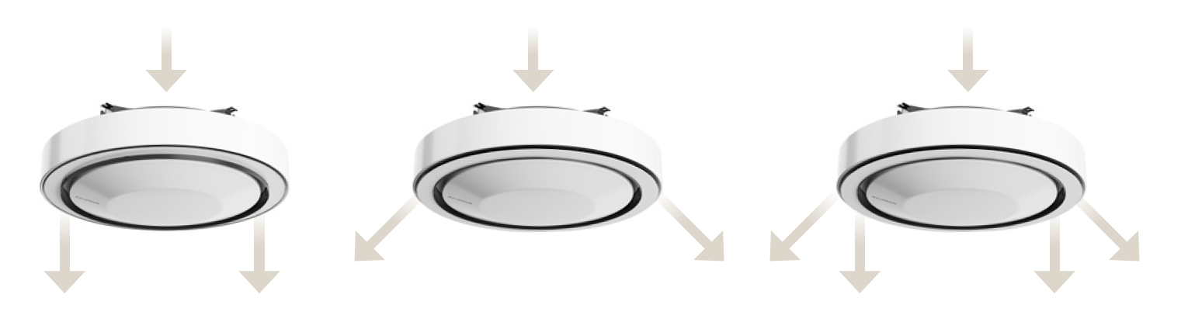
Principle of
operation
Optimal airflow
The 360° air nozzle automatically adjusts the direction of airflow based on the device's operating mode. It ensures even distribution of the air stream regardless of the room's height, providing uniform airflow throughout the space.

Slide 8
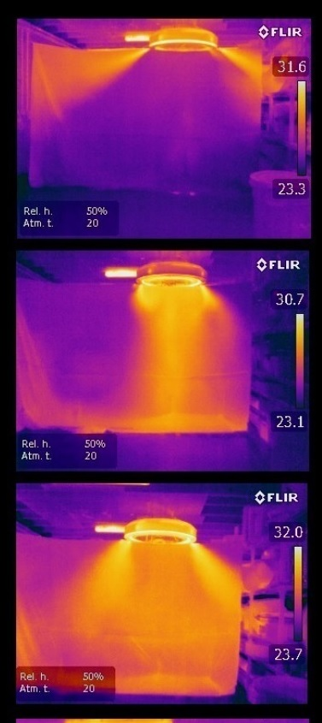
Airflow
- infrared simulation
Bottom air supply
Side air supply
Mixed air supply

Slide 9
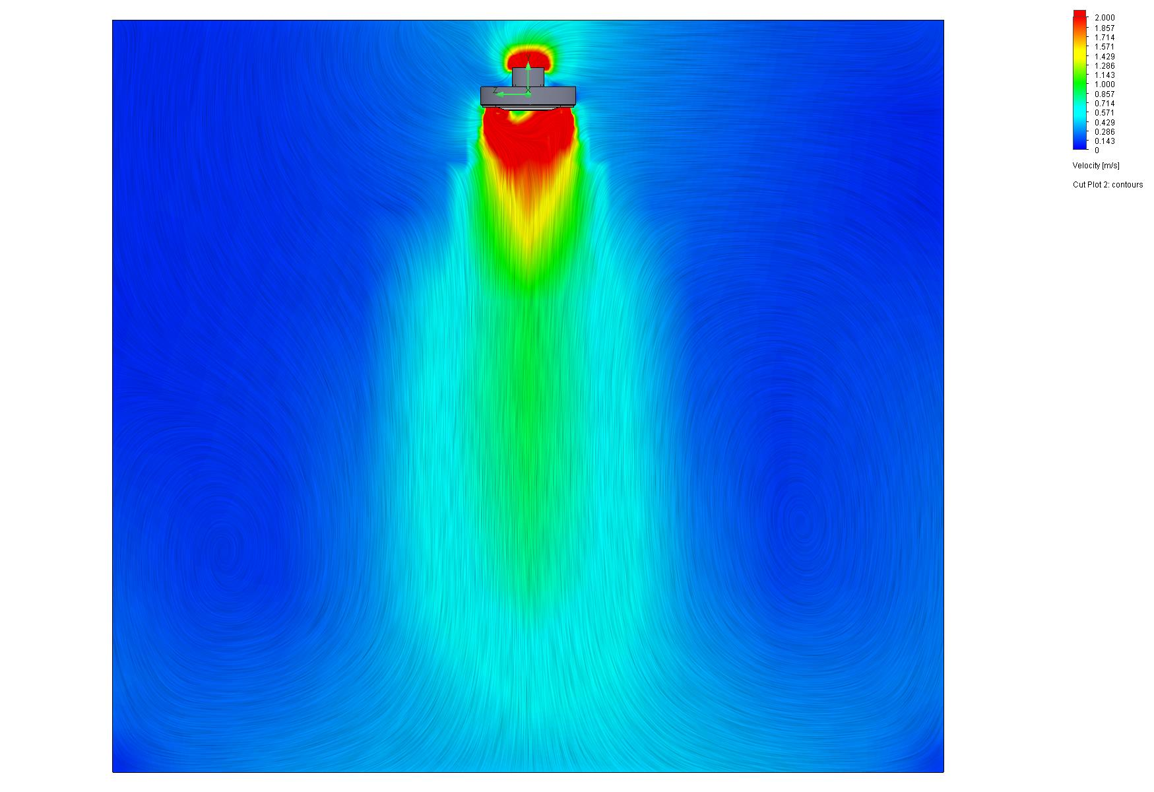
Airflow
- CFD simulation
Boundary conditions:
Temperature difference: 5K
Airflow rate: 3000 m3/h
Room height: 8 m
Air velocity at the edges: 0.5 m/s
Airflow range: 8 m

Slide 10
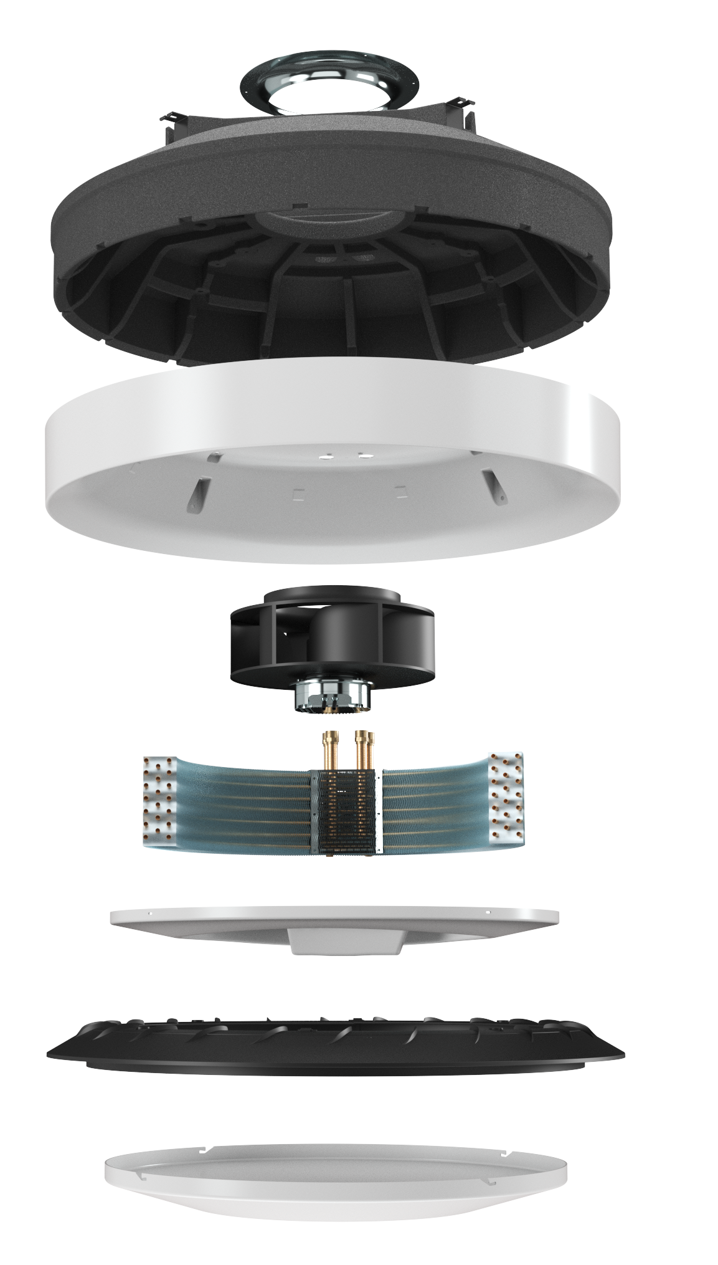
Filter Coarse 70% (~G4)
Components
used
EPP casing
ABS casing
EC fan
Radial water heat exchanger
Drain tray and condensate pump.
Automatic 360° nozzle.
Lower cover

Slide 11
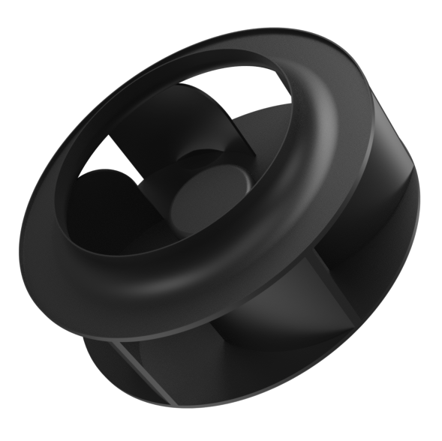
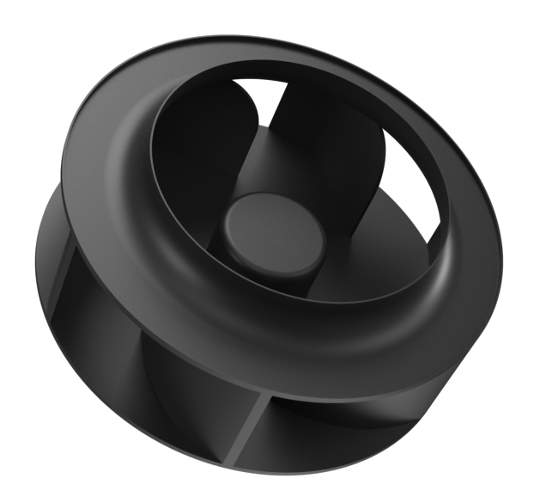
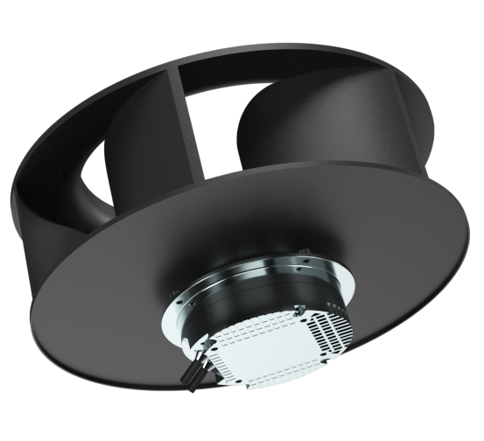
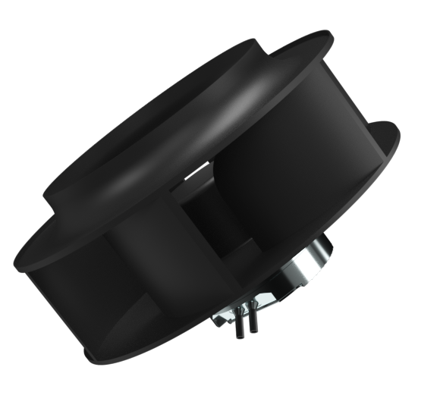
Radial
EC fan
Stepless EC fan
Luna is equipped with an advanced control system as a standard feature. The smooth regulation of the EC fan speed, based on the temperature difference, ensures minimal energy consumption..

Slide 12
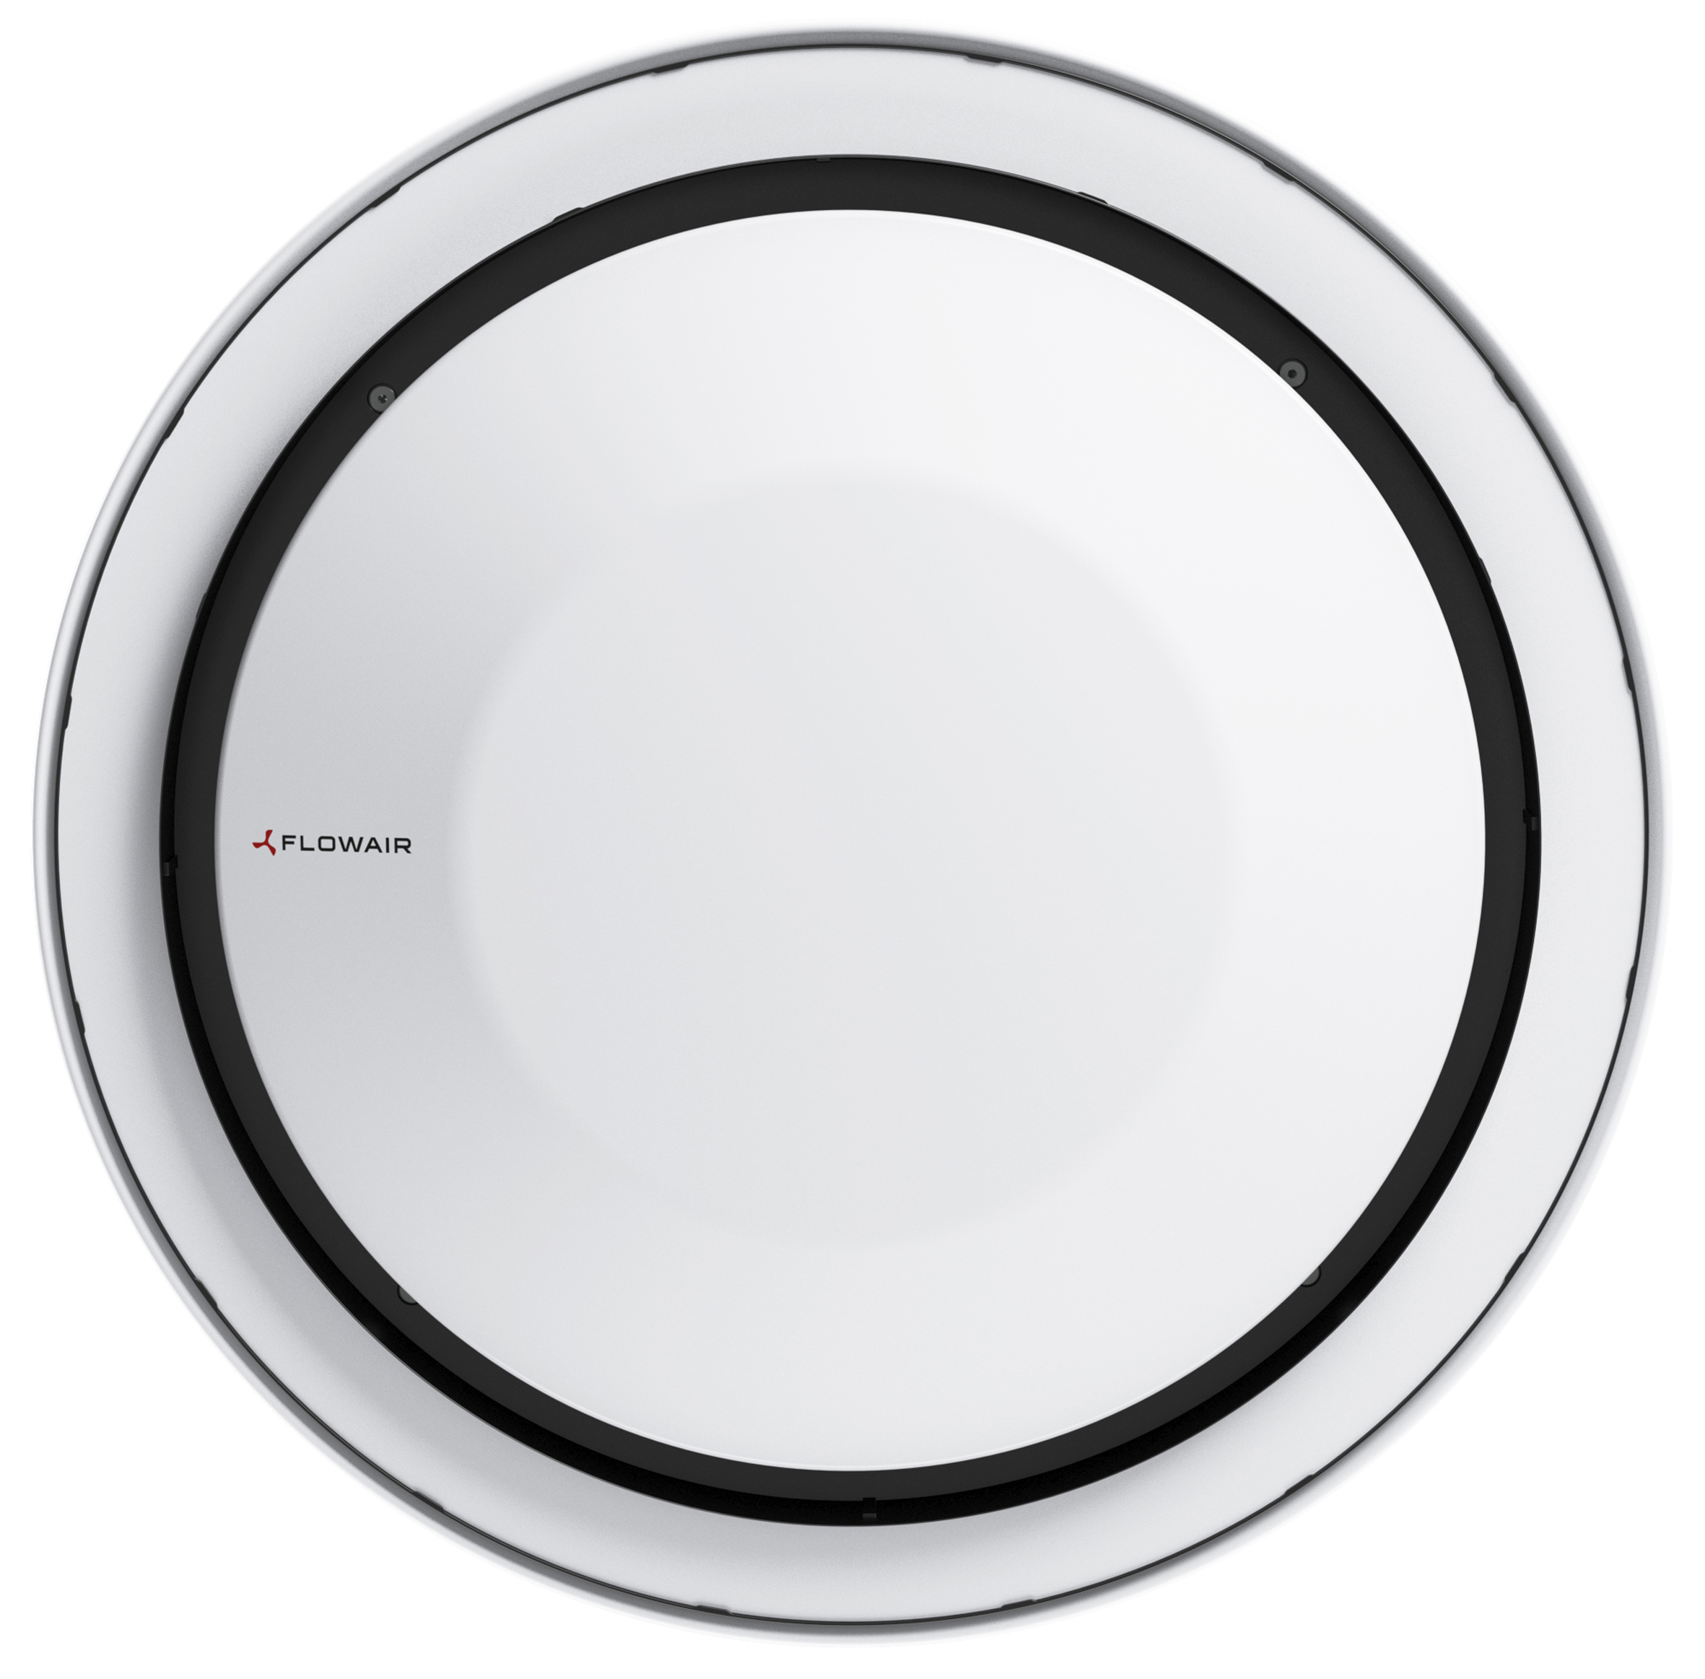
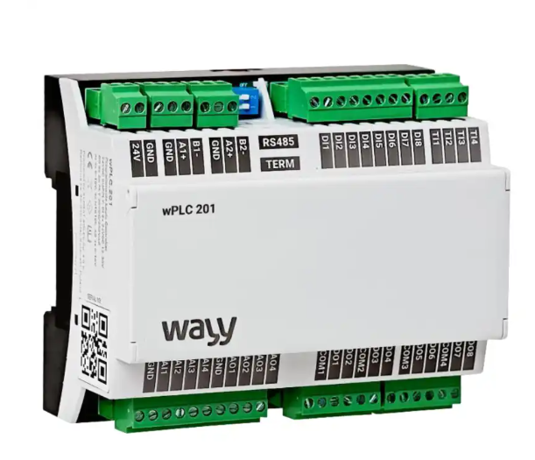
Plug
and play
Unit is delivered with fully functional controlling system. There is no need of complicated control cabinets.

Slide 13
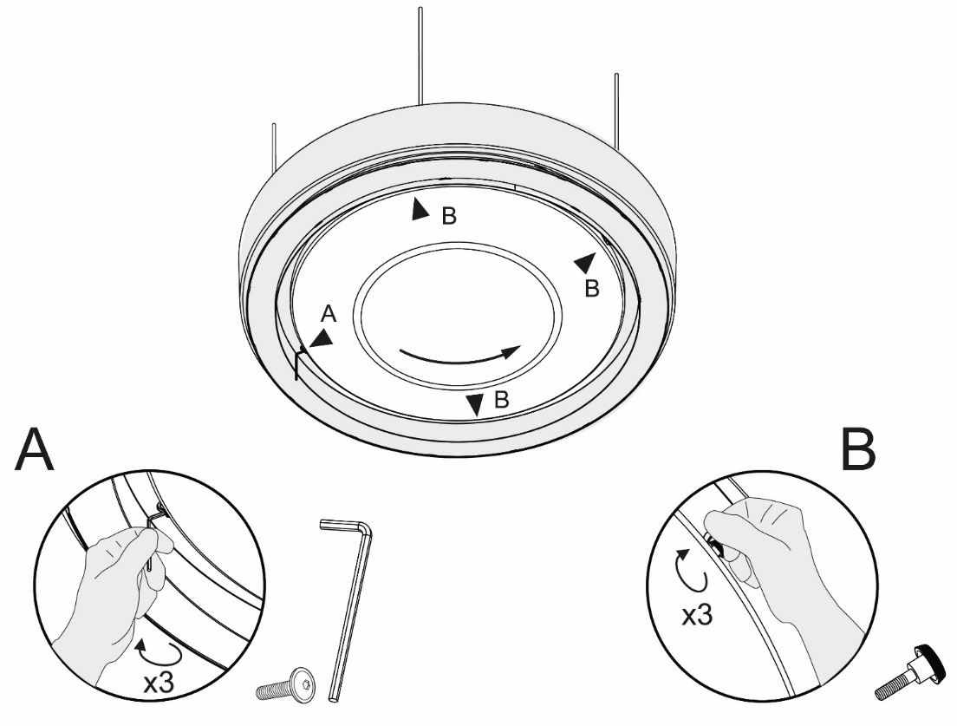
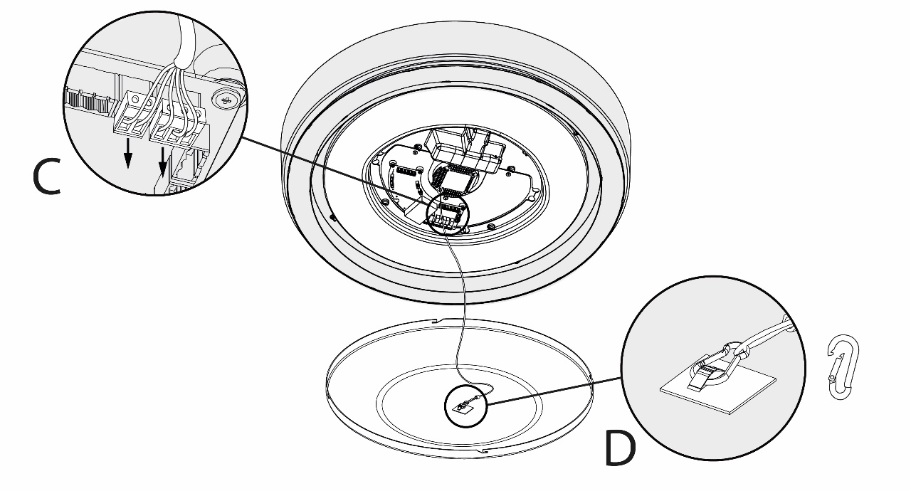
Service
access
Easy service
Fast service access to components from bottom.
Notes:
Aby zdjąc dolną pokrywę należy odkręcić 4 śruby jedna jest imbusowa (allen screw), pozostałe ręcznie. (1 Imbusowa ze względu na przepisy bezpieczeństwa)
The lid hangs on a cord with a carabiner. Po zdjęciu pokrywy mamy dostęp do sterownika(drv). Czyszczenie tacy (drain tray) wymaga tighten the next few wing screws (by hand) then we have access to the drain tray and the drain pump.

Slide 14
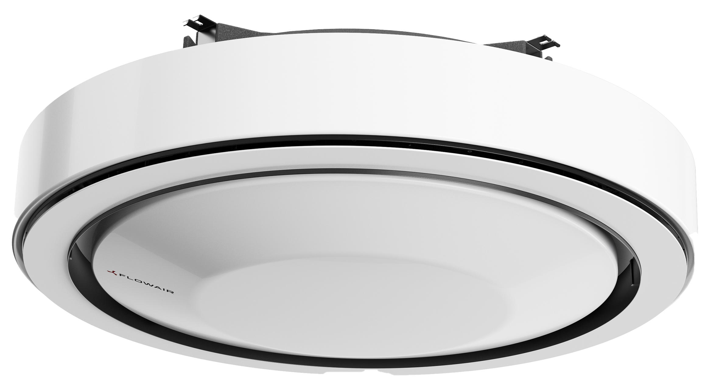
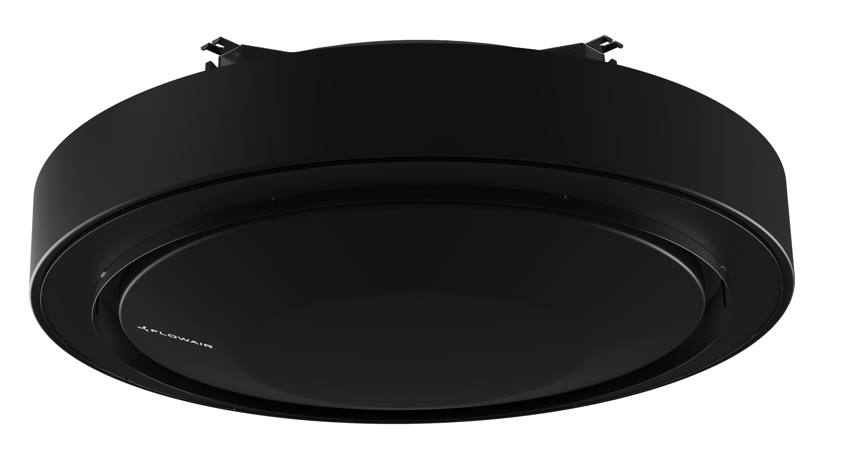
Luna
Types
Luna 2 H
2-pipe heating unit
Luna 2 HC
2-pipe heating and cooling unit
Luna 4 HC
4-pipe heating and cooling unit
Color options
Black and white

Slide 15
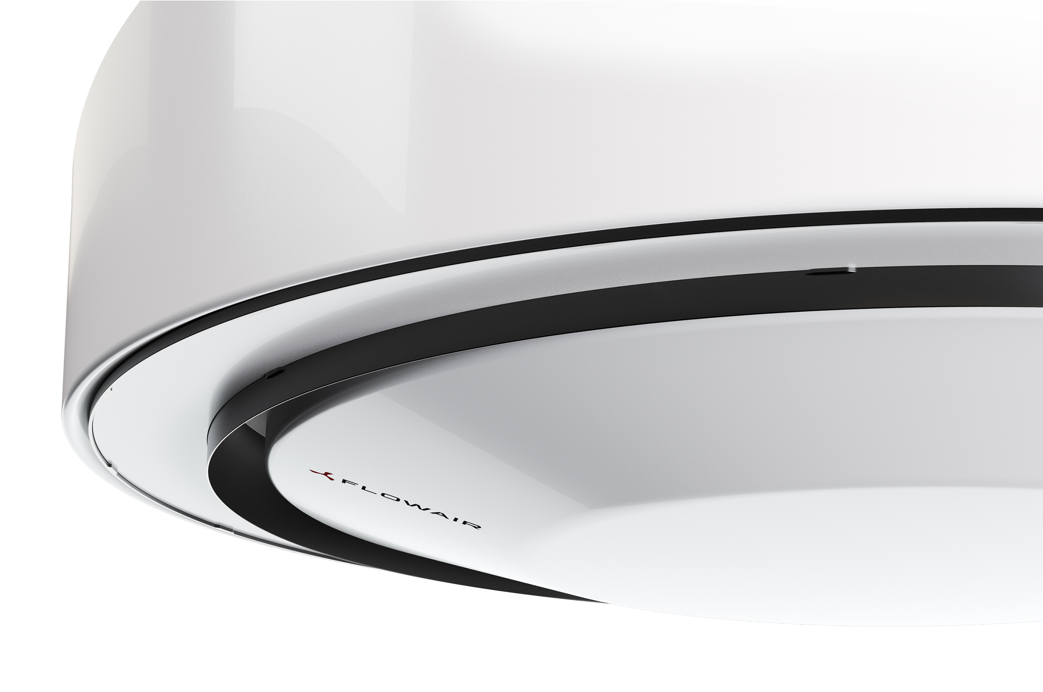
Basic
parameters
Heating capacity
32,5 kW (70/50° 16° C)
Range
up to 8,0 m
Cooling capacity
14,6 kW (7/12° 26° C 55%)
Airflow
3500 m3/h
Power supply
230/50 V/Hz
Weigth
33 kg
Acoustic pressure level
37 - 54 dB(A)
Automatic 360° air nozzle

Slide 16
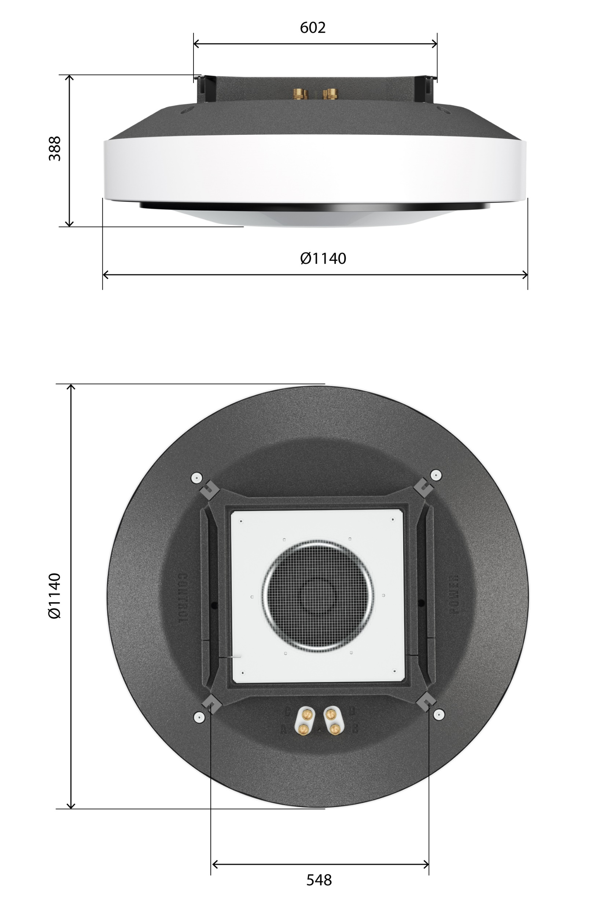
Luna
dimensions

Slide 17
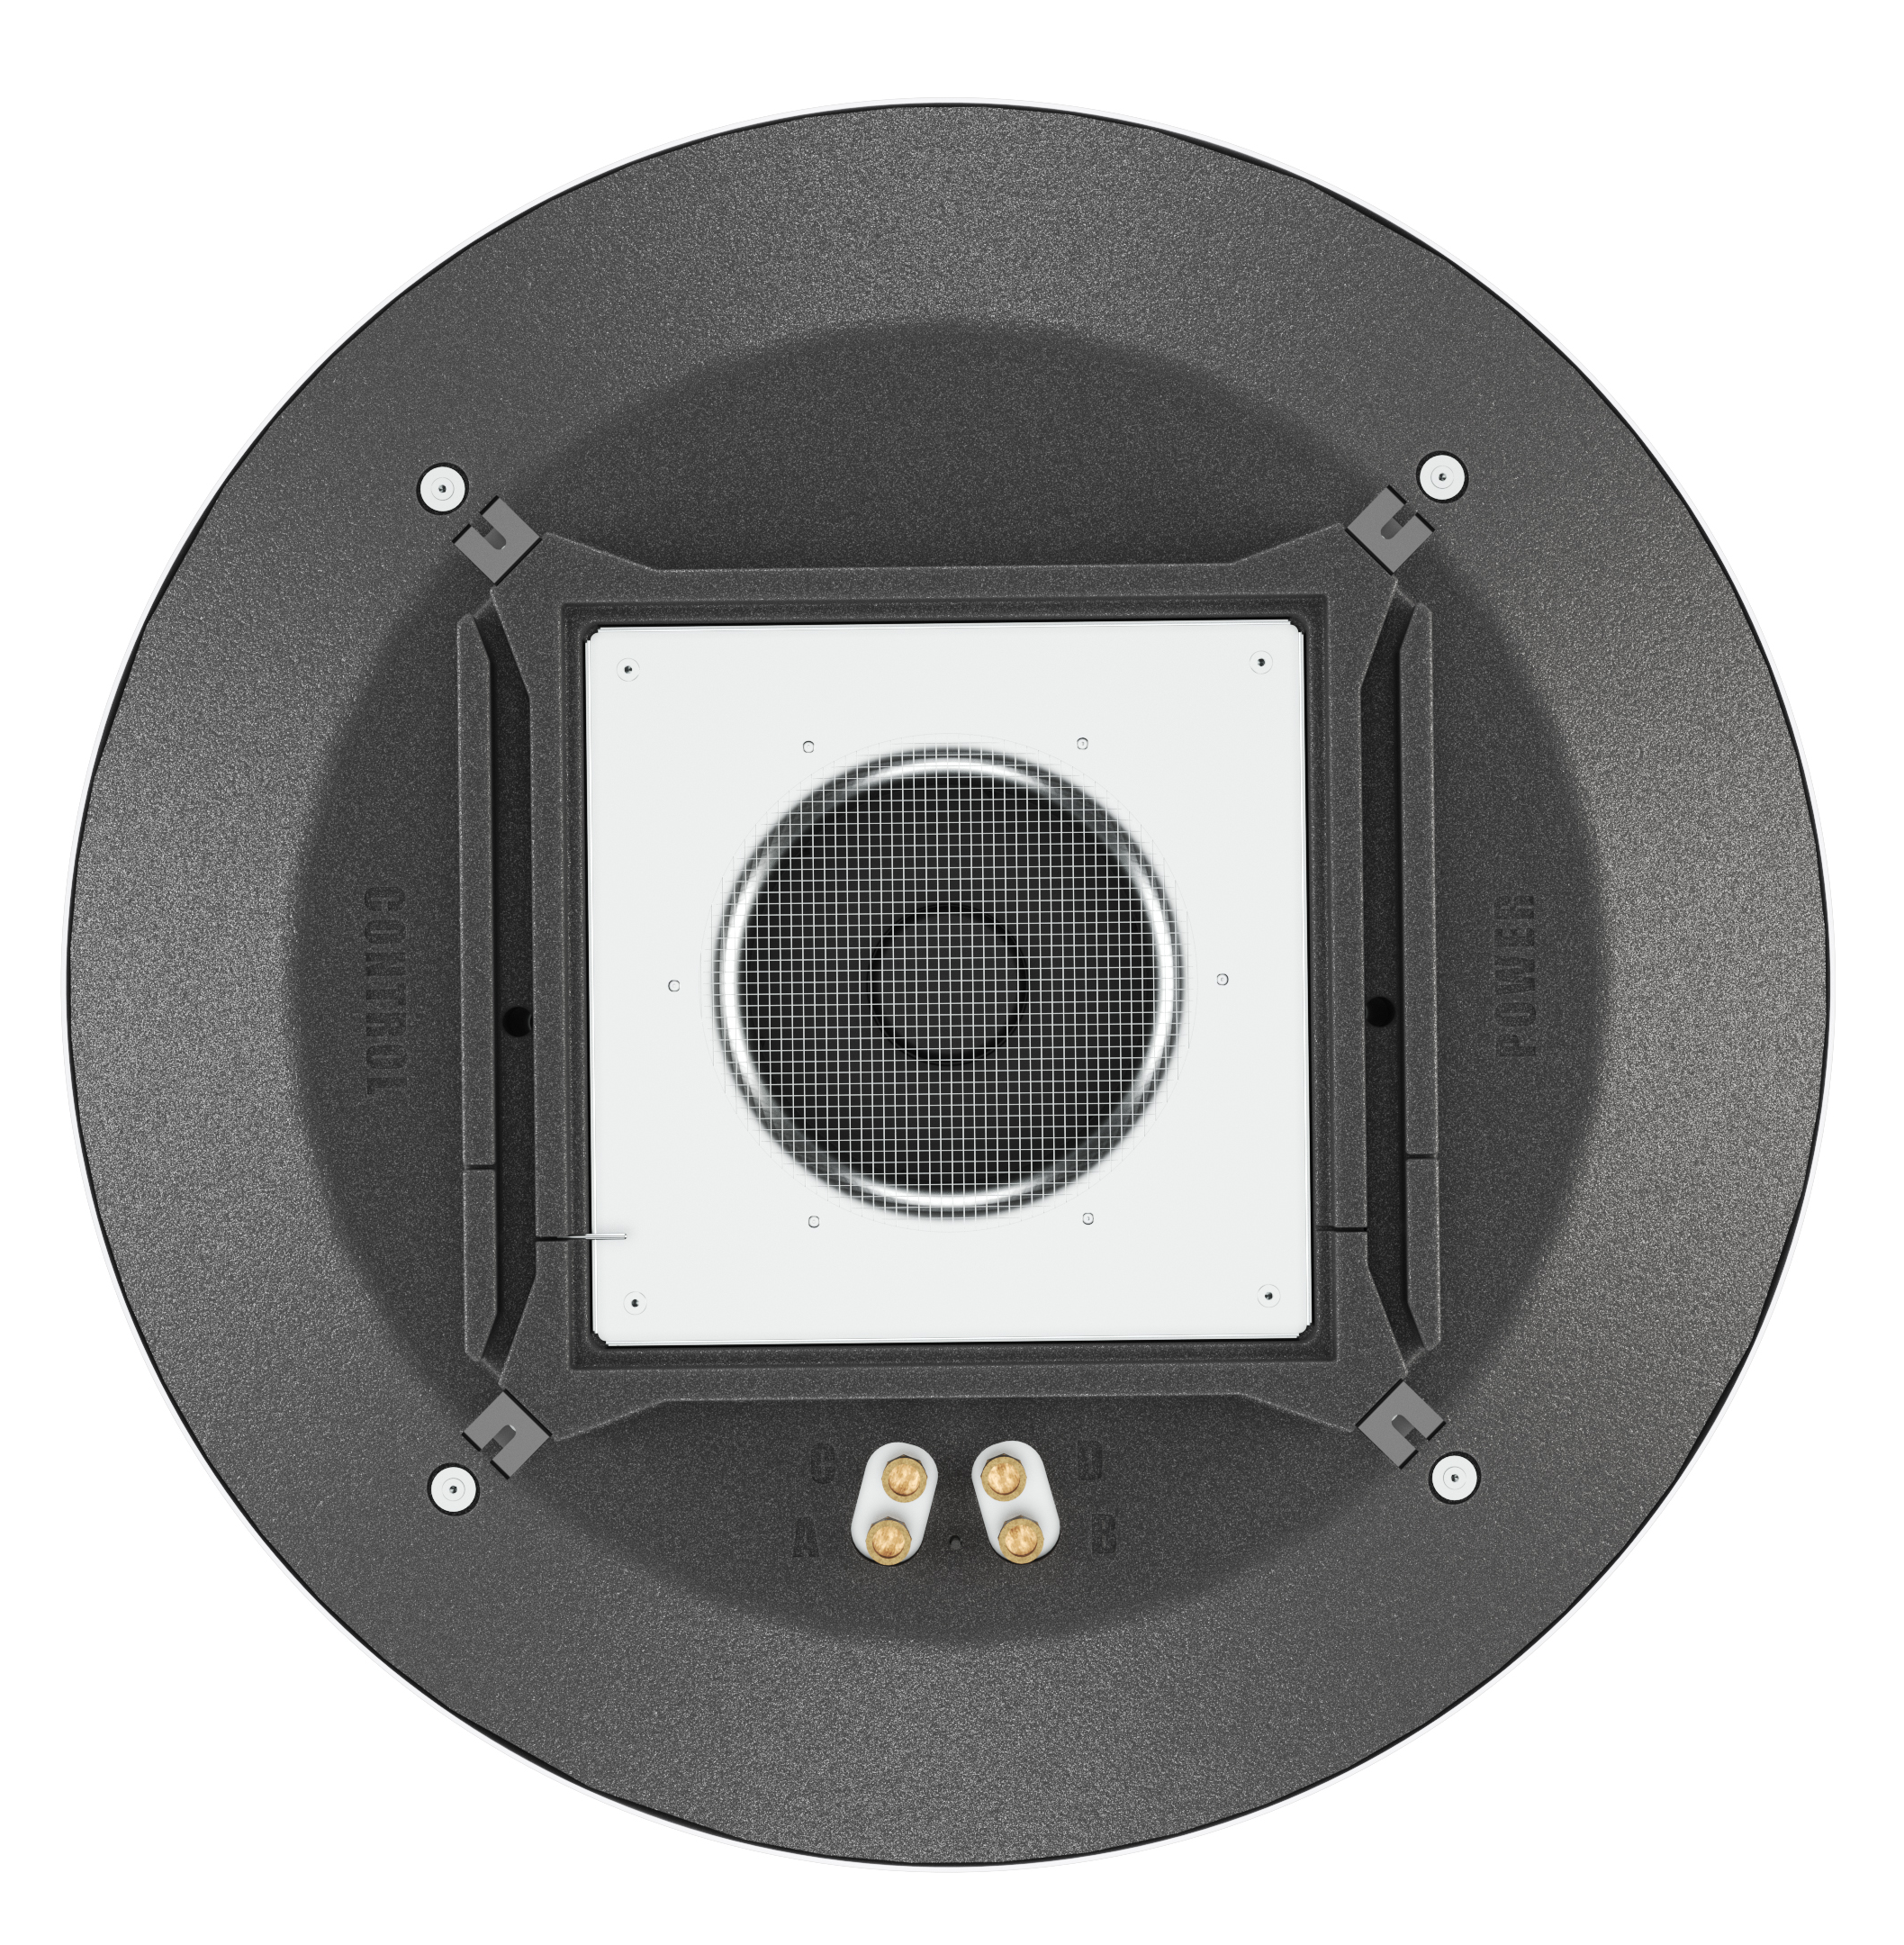
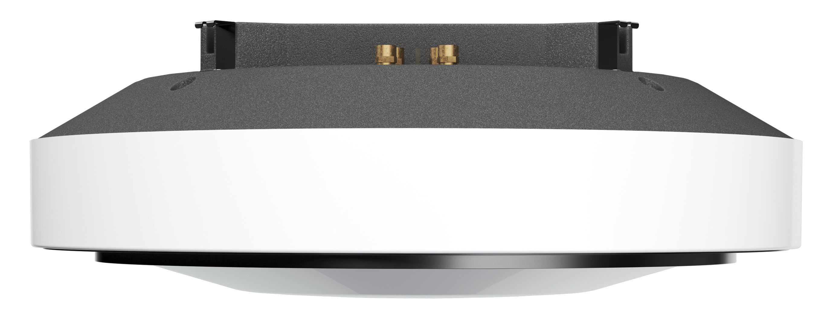
Luna
accesories
3-way valve with a 3-point actuator, 230V
2-way valve with an ON/OFF actuator, 230V
room temperature sensor (NTC10K)
drain tray for valve with actuator
blende for suspended ceiling install
filter Coarse 70%
adapter for the ventilation duct (diameter 450mm)
Soon:
Motion sensor
LED ring
Notes:
Automatyka jest gotowa na współprace z czujnikiem obecności / czujnikiem ruchu to tryb smart. Na razie sami nie mamy w ofercie takiego czujnika ale może pracować z czujnikiem zewnętrznym

Slide 18
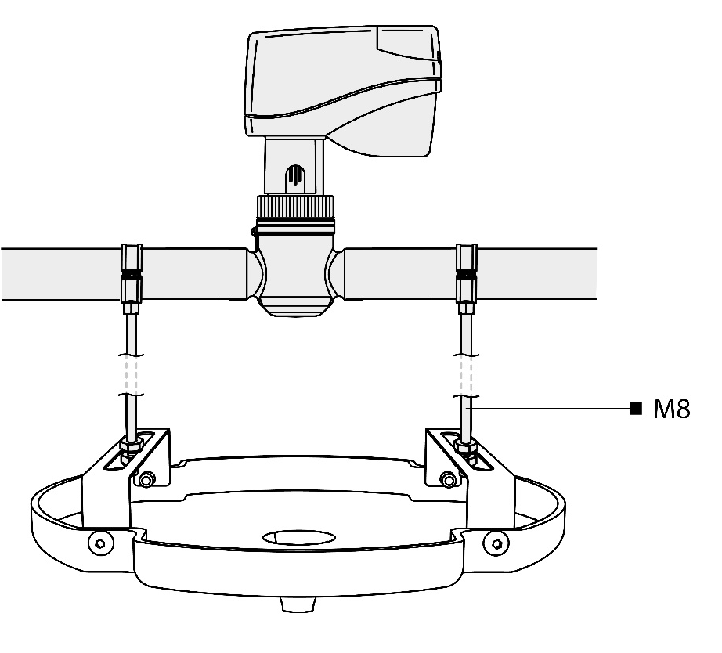
Luna
accesories
Drain tray
for condensate drainage to the valve and actuator (optional).

Slide 19
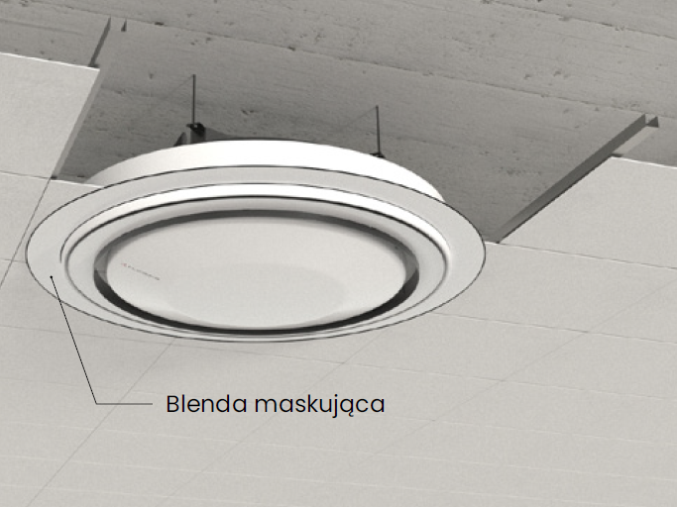
Luna
accesories
Blende for suspended ceiling install (opptional)
Notes:
Do urządzenia montowana na wcisk, przyklejana do sufitu na klej.

Slide 20
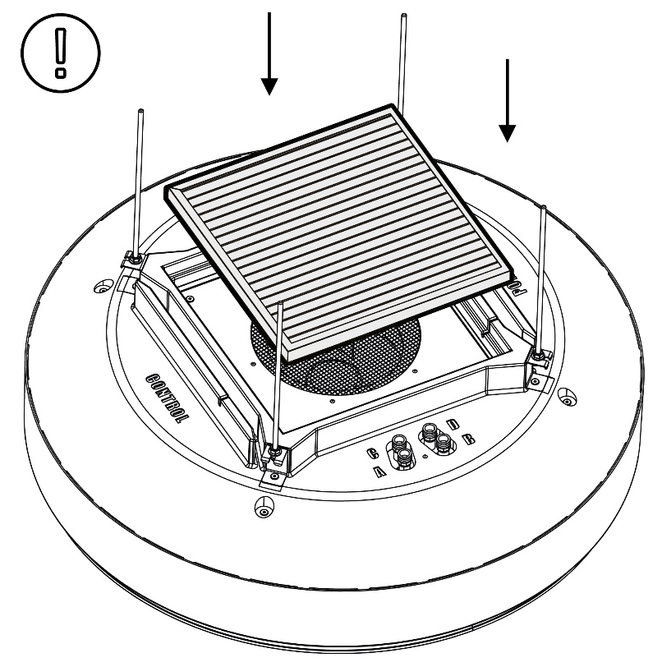
Luna
accesories
Filter Coarse 70% (G4) (in standard)
Installation on the top surface of the device.
The filter should be replaced periodically, depending on the level of contamination.

Slide 21
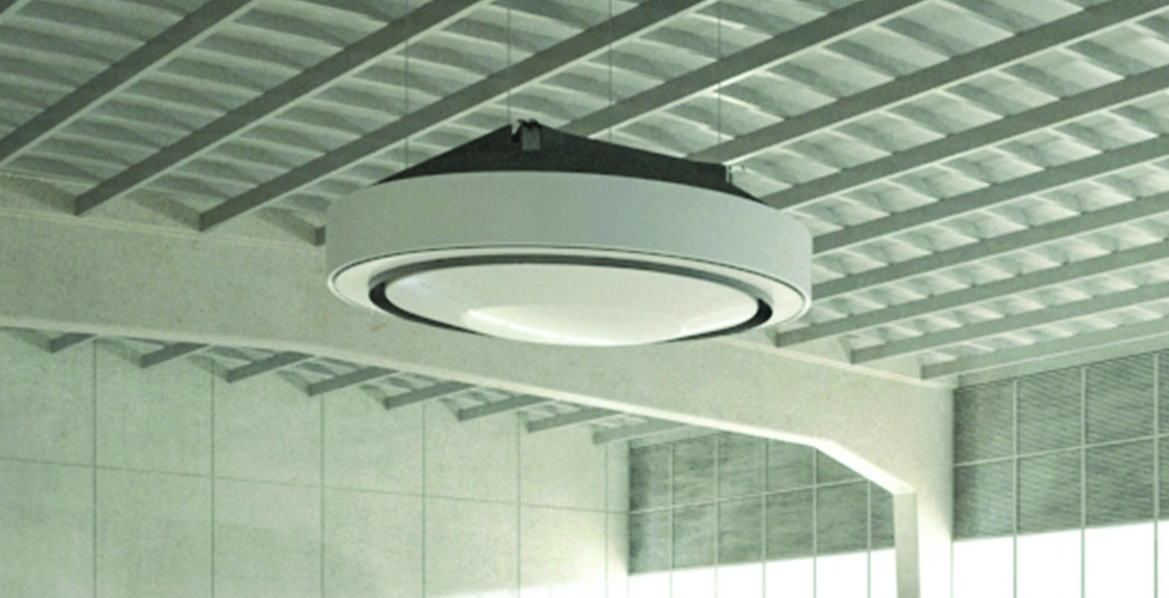
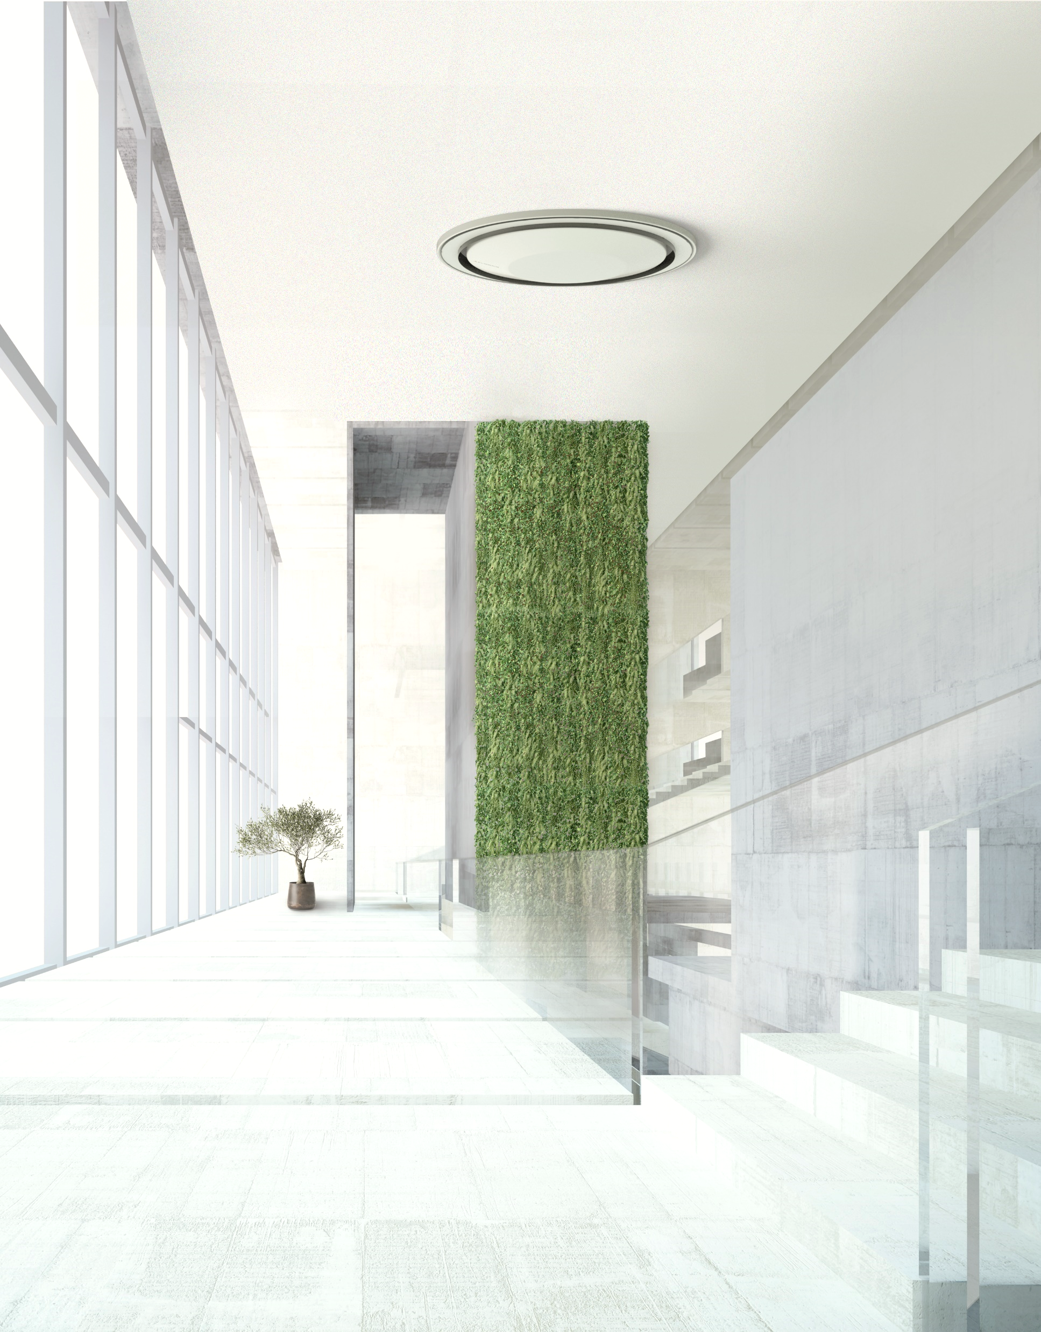
Installation
options
under the ceiling
in the suspended ceiling
ceiling air intake required

Slide 22
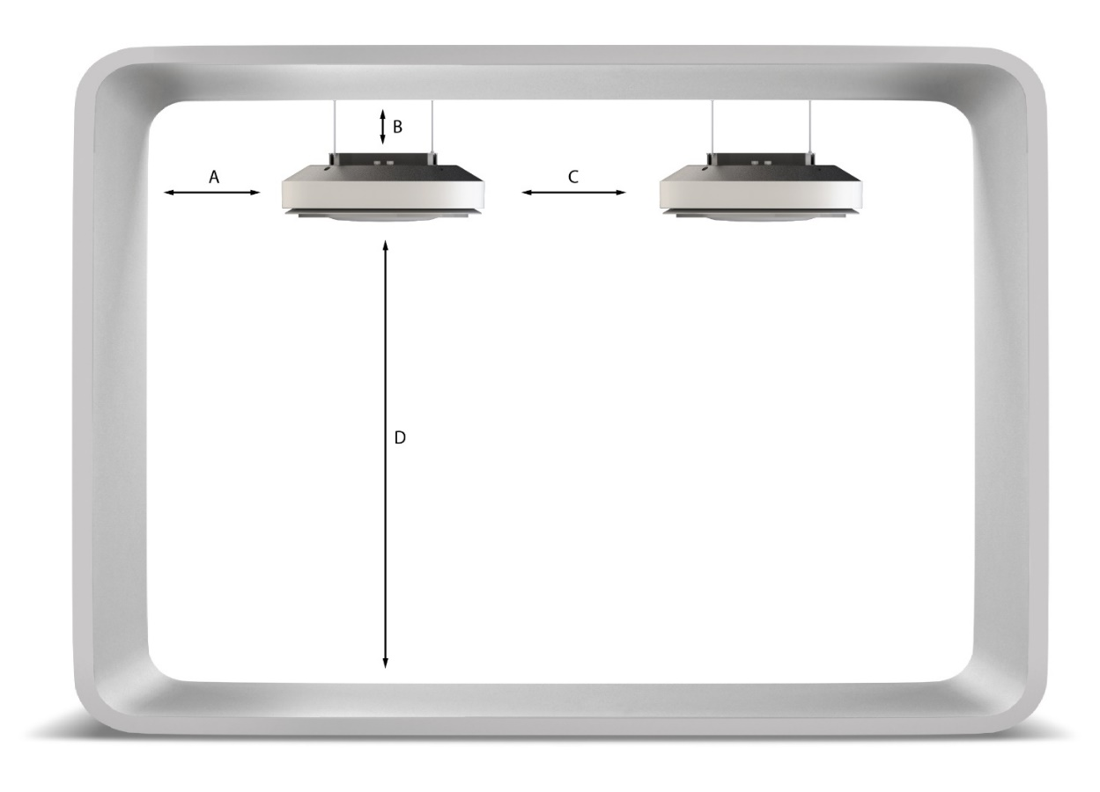
Installation
options
 | Dimension
A | min. 1 m
B | min. 15 cm
C | min. 2 m
D | max. 8 m*
*depending on the operating mode of the device
Notes:
Kluczowy wymiar jak blisko sufitu jesteśmy w stanie zamontować Lunę – 15 cm

Slide 23
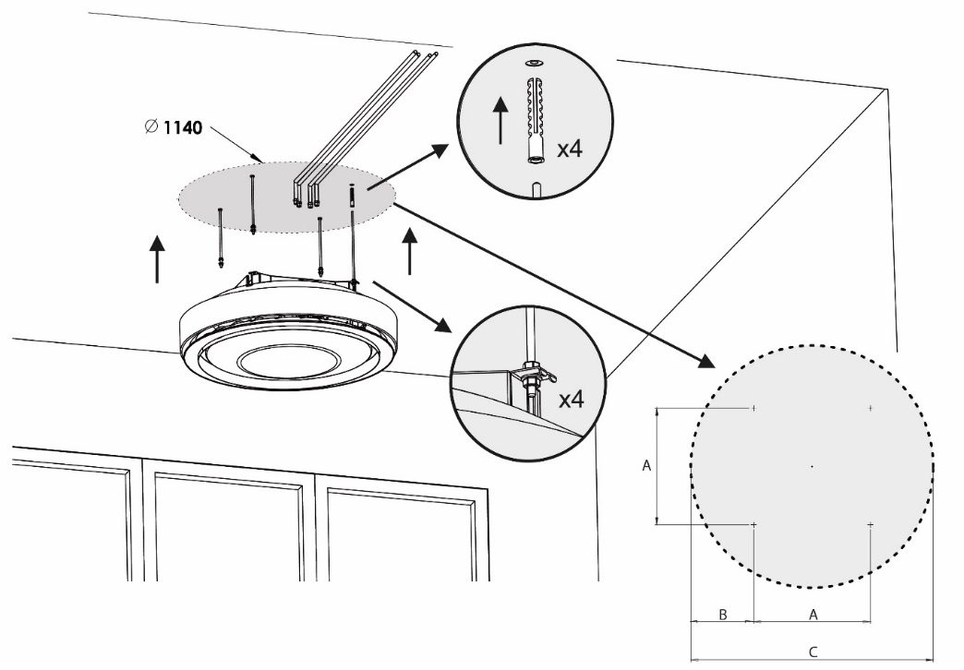
Installation
options
Oznaczenie | Wymiar
A | 548
B | 296
C | 1140
Notes:
Mounting pins M8, w zestawie nie mamy śrub ani szpilek, w kartonie nie ma też żadnego wzoru aby ułatwić wiercenie – często o to pytają

Slide 24
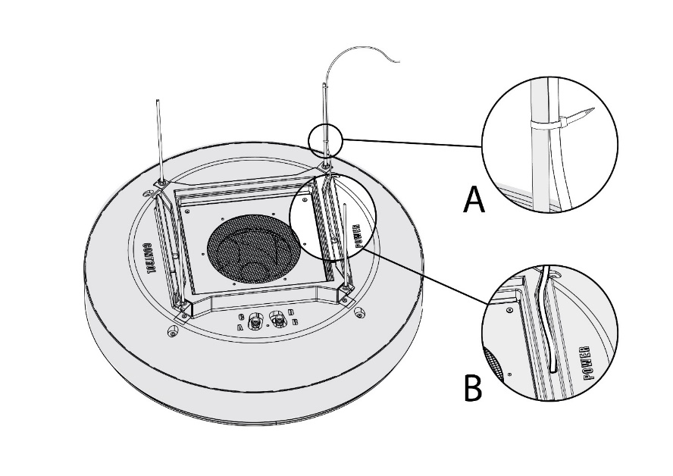
Power supply connection
Notes:
Podłaczenie zasialania:
Prowadzimy przewód zasialający po szpilce do urządzenia poprzez przygotowane korytko a następnie przez otwór po stronie opisanej wytłoczeniem jak Power
Ze sterowaniem podobnie tylko do otworu podpisanego jako control
Następnie podpinamy się zgodnie ze schematem do przygotowanych złączek do których dostęp mamy po zdjęciu dolnej pokrywy urządzenia
Podłaczenie hydrauliczne poprzez węże elestyczne do króćów w zależności od modelu urządzenia podłączenie wygląda różnie, króćce są opisane wytłoczeniem w EPP a tabela jak podłączyć w DTR

Slide 25
Controlling of the unit

